Slide 1
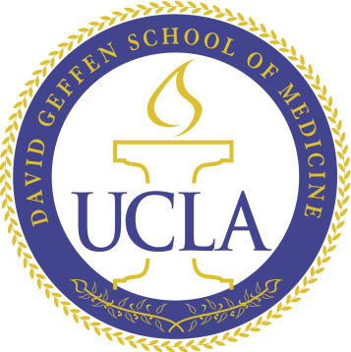
50 Years of
Liver Transplantation
Ronald W. Busuttil, MD, PhD
William P. Longmire Jr. Distinguished Professor
Executive Chairman, Department of Surgery
Chief, Division of Liver and Pancreas Transplantation
David Geffen School of Medicine at UCLA
Surgeon-in-Chief, Ronald Reagan UCLA Medical Center

Slide 2
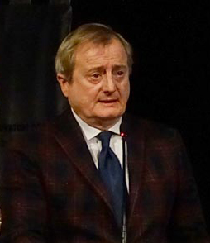

50 Years of Liver Transplantation
Professor
Andrea Risaliti, MD
Notes:
2

Slide 3
50 Years of Liver Transplantation
Past
Present
Future
Transforming lives
Notes:
3

Slide 4
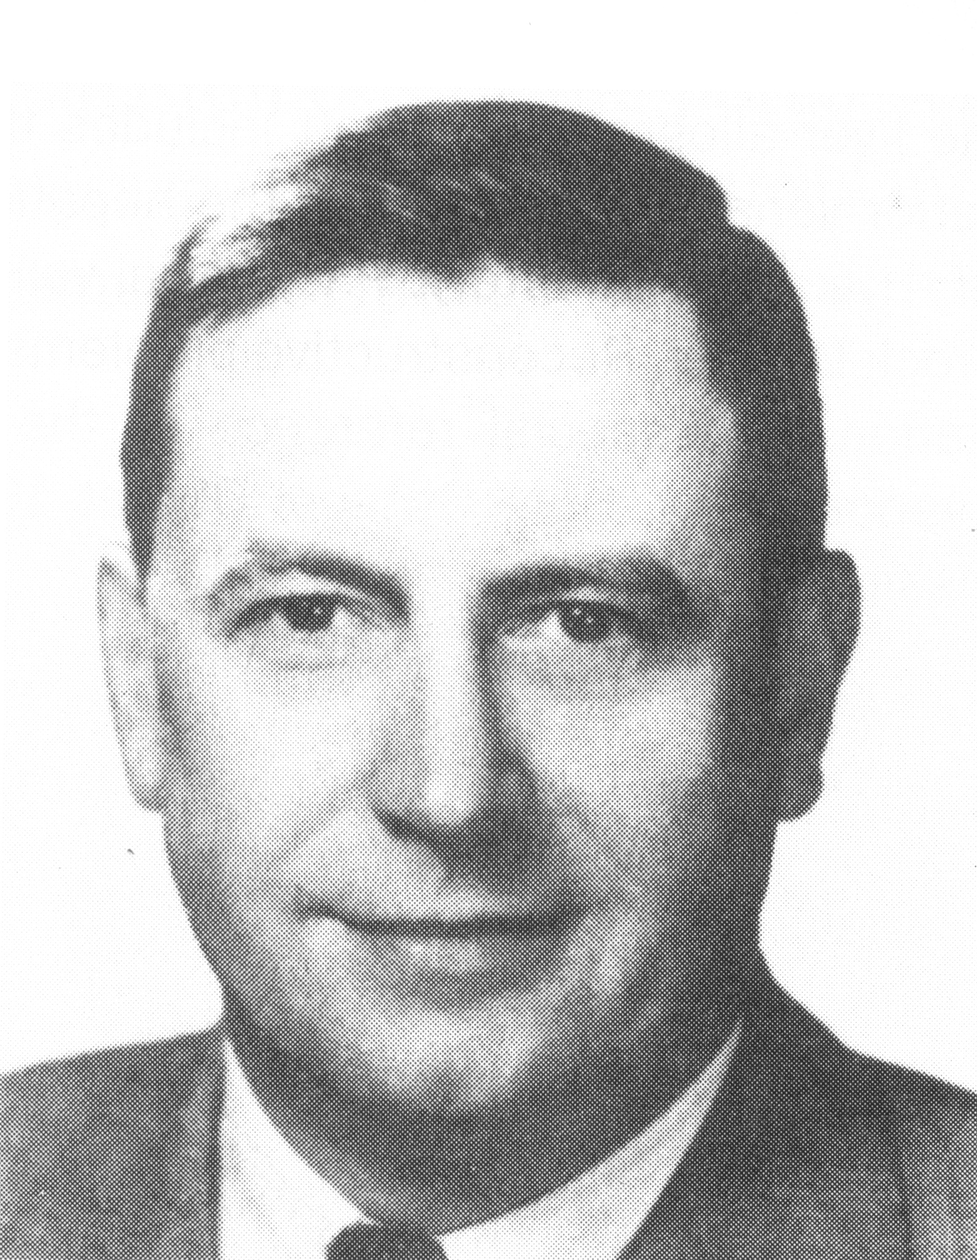
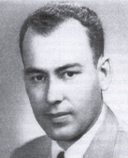
Origins of Liver Transplantation
50 Years of Liver Transplantation
 |  | First:
C. Stuart Welch Albany Medical College | ’55 | Experimental heterotopic LT
Jack A. Cannon UCLA | ’56 | Experimental OLT
Notes:
4

Slide 5
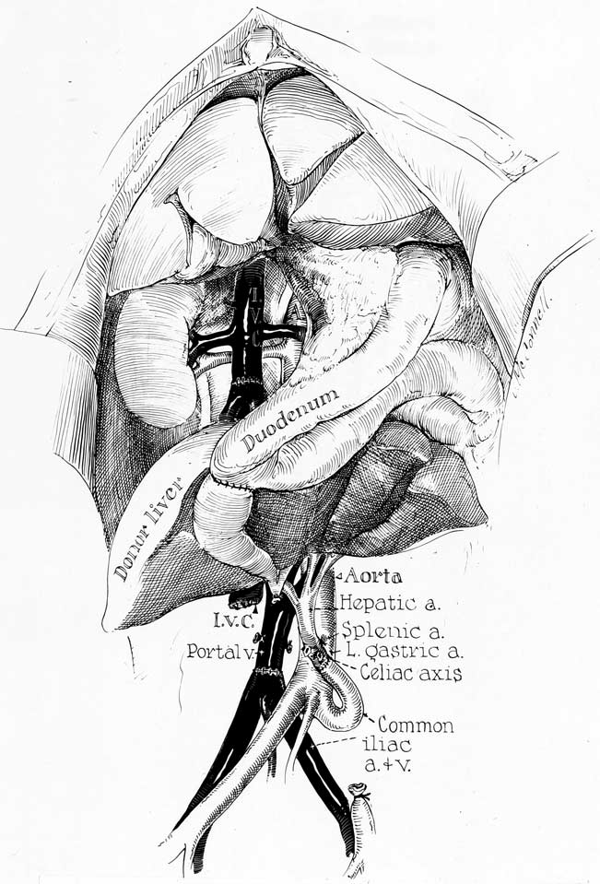
50 Years of Liver Transplantation
50 Years of Liver Transplantation
Heterotopic Liver Transplantation
Starzl, JACS 2002

Slide 6
50 Years of Liver Transplantation
American Journal of Transplantation 2012; 12: 1385–1387 © Copyright 2012 The American Society of Transplantation
Wiley Periodicals Inc. and the American Society of Transplant Surgeons
Special Article
The First Report of Orthotopic Liver Transplantation
in the Western World
R. W. Busuttil, L. G. De Carlis, P. V. Mihaylov,
B. Gridelli, L. R. Fassati and T. E. Starzl

Slide 7
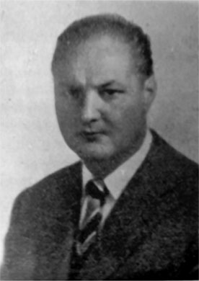
50 Years of Liver Transplantation
Origins of Liver Transplantation
Vittorio Staudacher
University of Milan
True pioneer of experimental
liver transplant 1952
Staudacher, La Riforma Medica 1952
Busuttil, AJT 2012

Slide 8
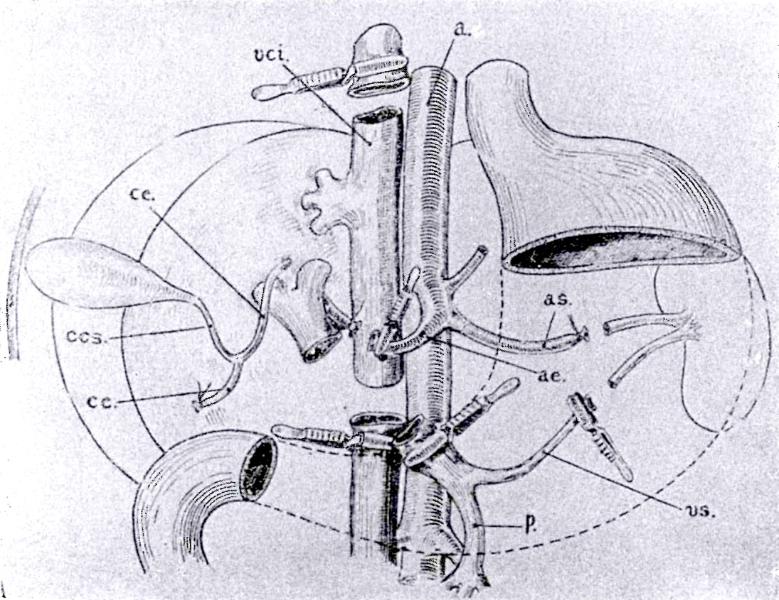
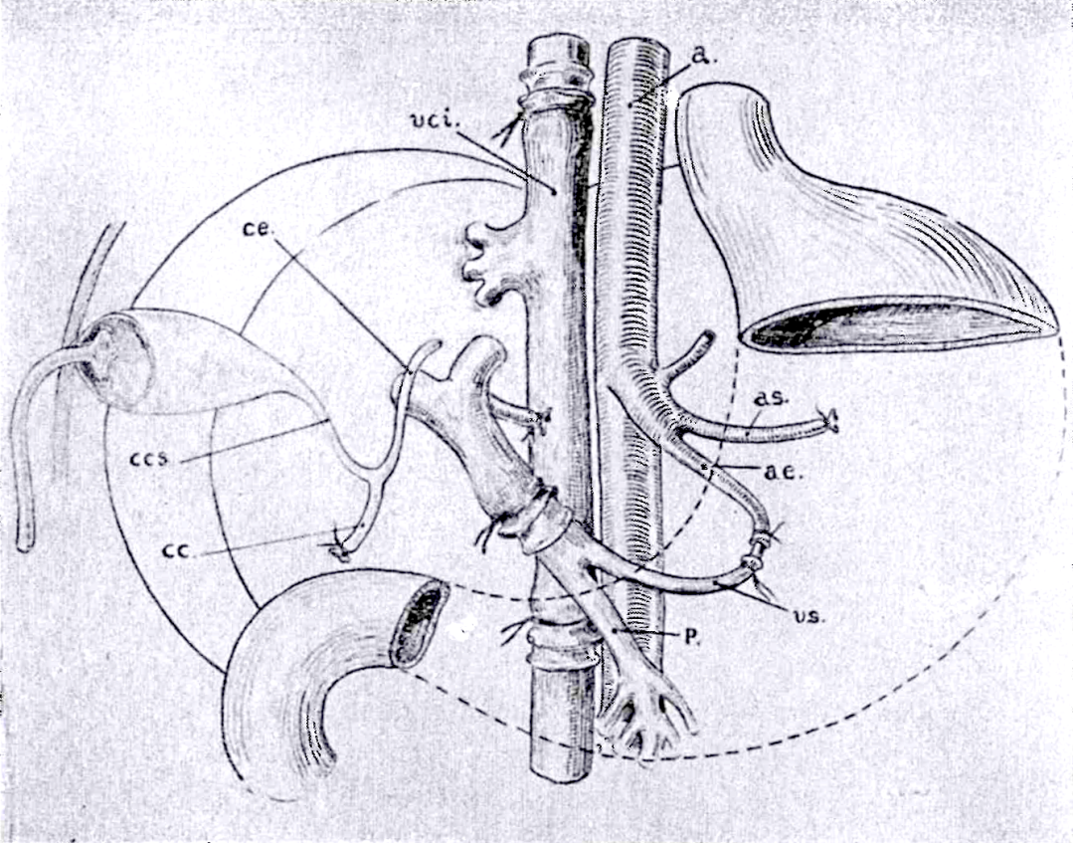
50 Years of Liver Transplantation
Origins of Liver Transplantation
Recipient hepatectomy in the dog
Donor liver graft implantation
Staudacher, Archives Italian Society of Surgery 1952

Slide 9
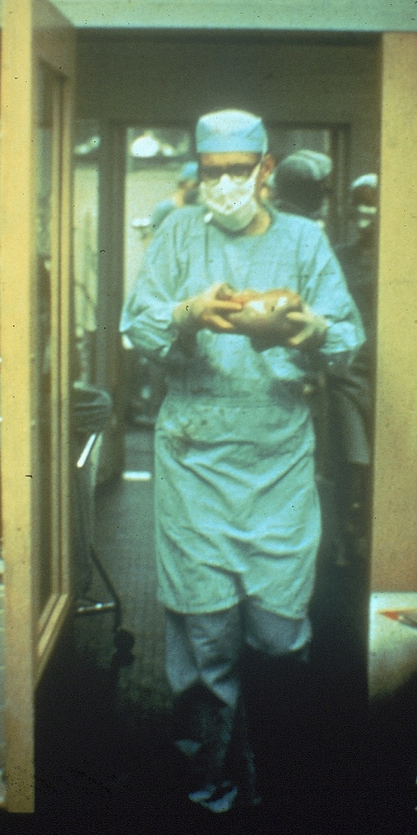
50 Years of Liver Transplantation
Thomas E. Starzl
World’s first 3 attempts at liver transplantation 1963
SURGERY
Gynecology & Obstetrics
D E C E M B E R 1 9 6 3
V O L U M E 1 1 7
N U M B E R 6
HOMOTRANSPLANTATION OF THE LIVER IN HUMANS
T. E. STARZL, M.D., F.A.C.S., T. L. MARCHIORO, M.D., K. N. VON KAULLA, M. D.,
G. HERMANN, M.D., R. S. BRITTAIN, M.D., and W. R. WADDELL, M.D., F.A.C.S.,
Denver, Colorado
Notes:
9
Slide 7: Starzl First 5 Attempts
On March 1st, 1963, the first liver human transplant was performed by Dr. Starzl in Denver, Colorado. The recipient was a three year old child with biliary atresia who died on the operating table from exsanguinating hemorrhage. The story of Bennie Solis, that first recipient, is described fully in Dr. Starzl’s book “The Puzzle People” and I highly recommend it to you all.

Slide 10
50 Years of Liver Transplantation
First Seven Liver Transplant Cases
Age
3
48
68
52
58
29
75
Date
03/63
05/63
06/63
07/63
09/63
10/63
01/64
City
Denver
Denver
Denver
Denver
Boston
Denver
Paris
Diagnosis
Biliary Atresia
Hepatoma w/Cirrhosis
Duct Cell Carcinoma
Hepatoma w/Cirrhosis
Colon Metastases
Hepatoma
Colon Metastases
Survival (Days)
0
22
7.5
6.5
11
23
0
Starzl, JACS 2002
Notes:
Slide 8: First 7 Liver Transplant Cases
Six other attempts at liver replacement were made through January 1964. Five in Denver by Starzl, one in Boston by Francis Moore and one in Paris by Professor Demirleau which is the first recorded attempt outside of the US. The longest survivor was 23 days and all died of surgical complications. Note that 6 of the 7 transplants were performed for primary or secondary cancer of the liver.

Slide 11
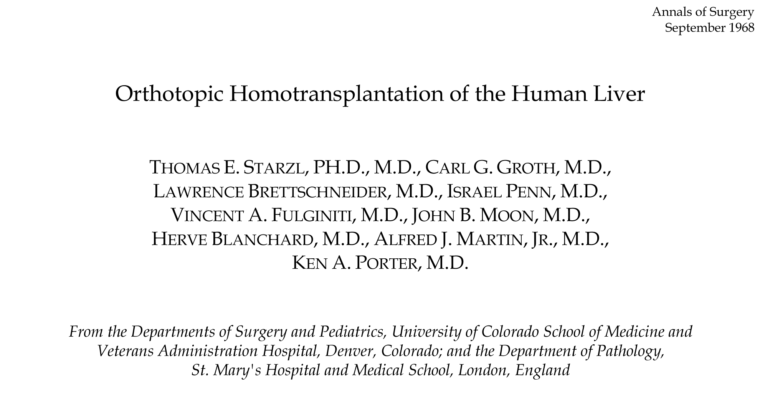
50 Years of Liver Transplantation
Presented at the ASA 1968
“This is a magnificent achievement, and liver surgery as of this day has an entirely new look from hither forward.”
Francis Moore, MD

Slide 12
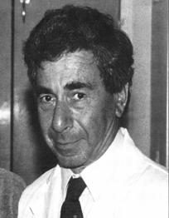
50 Years of Liver Transplantation
First Successful Liver Transplant in Europe
Cambridge, UK May 1968
Sir Roy Calne

Slide 13
50 Years of Liver Transplantation
First Piggyback Procedure
Calne, BMJ 1968
Notes:
Left: Figure 4 – Piggyback hepatectomy with the vena cava intact, hepatic veins clamped, and portal vein shunt directly into the right IJ
Right: Figure 5 – Piggyback liver sewn in with the suprahepatic VC of donor sewn to HV cuff, the infrahepatic VC ligated, and a choleCYSTO-choledochostomy.

Slide 14
50 Years of Liver Transplantation
Donor Shortage
Transplantation limited by lack of suitable donors - especially for children
Led to technical advances in partial graft transplantation
Notes:
14

Slide 15
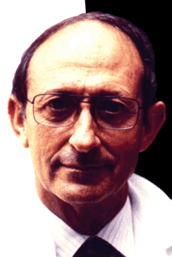
50 Years of Liver Transplantation
First Reduced Sized Graft
Villejuif, France 1981
Reduced-sized orthotopic liver graft in hepatic transplantation in children
H. Bismuth, M.D., and D. Houssin, M.D., Villejuif, France
Surgery
March 1984
Volume 95
Number 3
Henri Bismuth

Slide 16
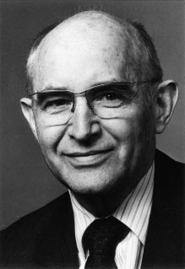
50 Years of Liver Transplantation
First Split Liver Transplant
Hannover, Germany 1988
Rudolf Pichlmayr

Slide 17
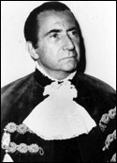
50 Years of Liver Transplantation
First Attempt at Living Donor
São Paulo, Brazil 1989
Silvano Raia

Slide 18
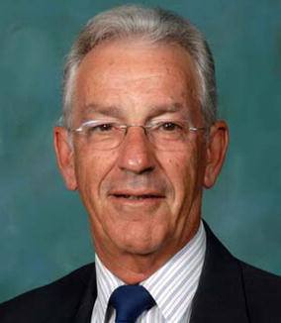
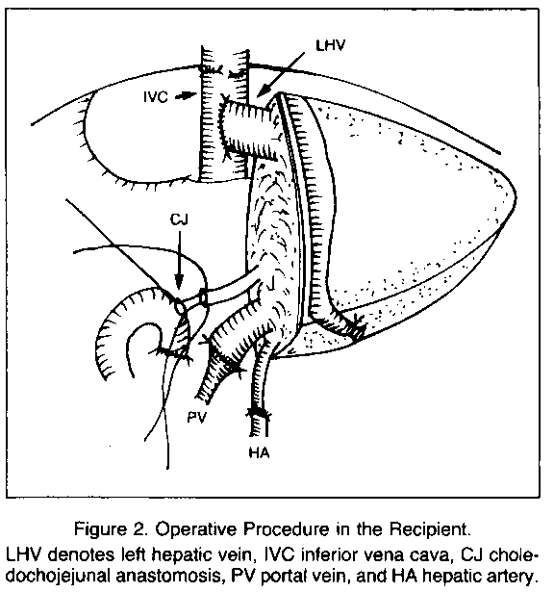
50 Years of Liver Transplantation
First Living Donor Transplant
Australia, 1990
Russell W. Strong

Slide 19
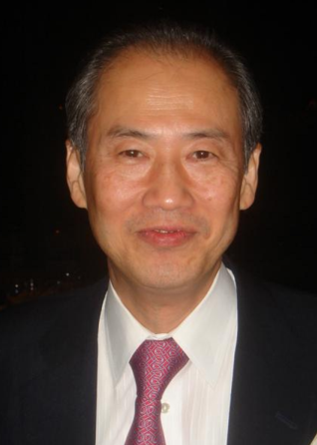
50 Years of Liver Transplantation
First ADULT Left Lobe Living Donor
Matsumoto, Japan 1994
Masatoshi Makuuchi

Slide 20
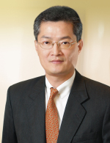
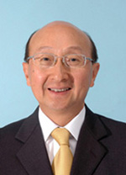
50 Years of Liver Transplantation
First Right Lobe Living Donor Transplant
Hong Kong, China 1997
CM Lo and ST Fan

Slide 21
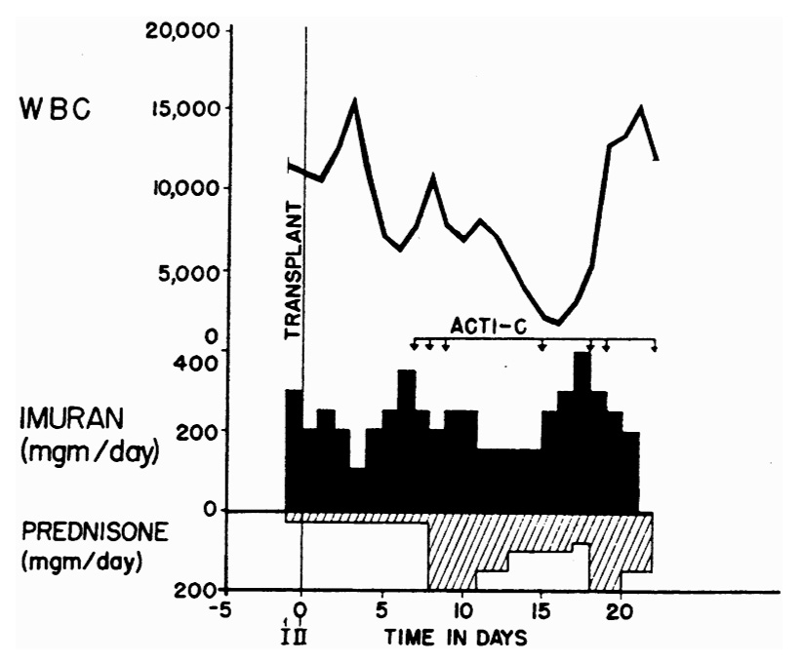
Immunosuppression in First Patient to Survive Liver Transplantation
50 Years of Liver Transplantation
Starzl TE, J Am Coll Surg, 2002
Notes:
Immunosuppression with azathioprine (Imuran) & prednisone in first patient to survive orthotopic liver transplantation (patient 2).
ACTI-C: doses of actinomycin C (From: Starzl TE, Marchioro TL, Von Kaulla KN, et al. Homotransplantation of the liver in humans. Surg Gynecol Obstet 963;117:659-676)
Immunosuppression was same as that used for kidney recipients; pretreatment was begun with azathioprine with or without small doses of prednisone; the same therapy was continued after transplantation; with evidence of rejection, a high-dose course of prednisone was added (shown in this slide).

Slide 22
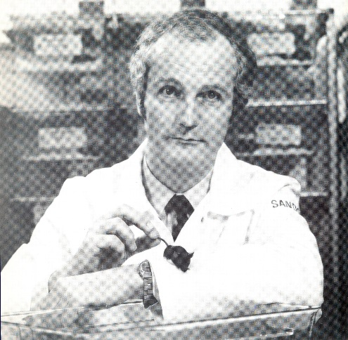
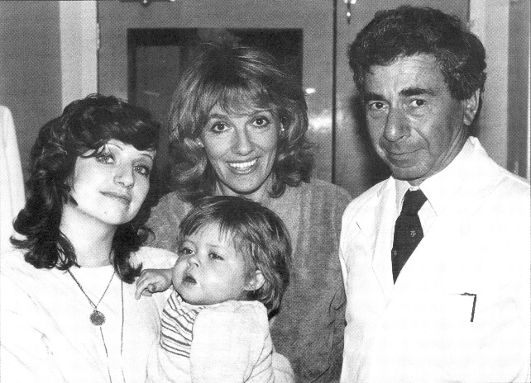
Cyclosporine
50 Years of Liver Transplantation
1976: Immunosuppressive effects discovered by Jean Borel and A. Ruegger
1978: Used to treat graft vs host
in BMT by Ray Powles
1978-: Initial trials in renal
1979 transplant conducted
by Roy Calne
Notes:
Cyclosporine: metabolite generated by Tolypocladium infla
tum (a type of fungus); cyclic peptide; Borel showed it prolonged survival of skin grafts;
Initial human use based on animal dose & consequently severely nephrotoxic;

Slide 23
Historical Perspective
Cyclosporine Based Immunosuppression
50 Years of Liver Transplantation
“The Advent of Cyclosporine Dramatically Transformed Clinical Liver Transplantation”
 | Pre CyA | Post CyA
Patient Survival (1 year) | 30-35% | 63-65%
Graft Survival (1 year) | 30-35% | 63-65%
Rejection | 66% | 25%
Cohen, J Annals Int Med, 1984

Slide 24
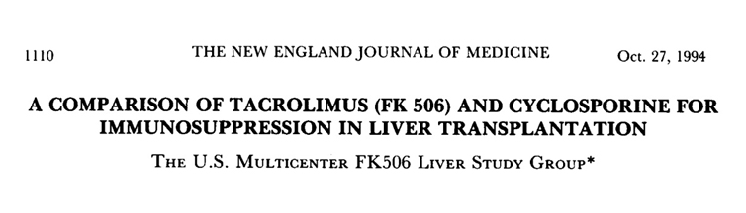
Pivotal Trial Results
50 Years of Liver Transplantation
Notes:
Andrew to complete

Slide 25
U.S. Phase III Liver Study Design
50 Years of Liver Transplantation
Tacrolimus vs cyclosporine
Randomized
Multicenter
Open label
n=555
Pediatric and adult
Notes:
Slide #2: Liver Study Design
“The original Phase III, NDA-directed study was prospectively randomized and open-label in nature. The trial compared the safety and efficacy of Prograf® (tacrolimus) vs. the Sandimmune® formulation of cyclosporine in pediatric and adult orthotopic liver transplant recipients. These data include the NDA-directed 1-year randomized, multicenter trial and a 4-year follow-up extension study. A total of 12 centers in the United States participated in the study which evaluated patients from August 1990 through October 1996.
The U.S. Multicenter FK506 Liver Study Group. A comparison of tacrolimus (FK506) and cyclosporine for immunosuppression in liver transplantation. N Engl J Med 1994;331:1110-5

Slide 26
U.S. Phase III Liver Study
50 Years of Liver Transplantation
Summary of Efficacy Results One-Year
Kaplan-Meier Estimates
(Acute Rejection, OKT3 Usage, Refractory Rejection)
Parameter
FK506
CBIR
DIFF
95% CI’s
Acute Rejection
68.1%
76.0%
-8.0
-17.0% 1.1%
OKT3 Usage
19.1%
35.6%
-16.5
-25.2% -7.8%
Refractory Rejection
3.0%
14.8%
-11.8
-17.5%
-6.1%

Slide 27
5-Year Patient Survival by Baseline Hepatitis C Status
Hepatitis C Positive
50 Years of Liver Transplantation
U.S. Phase III Liver Study
100
90
78.9%
80
% Survival
p = 0.041
70
60
FK506
CyA
60.5%
50
p = 0.041
0
0
200
400
600
800
1000
1200
1400
1600
1800
Time in Days
Notes:
Slide #9: 5-Year Patient Survival Among Hepatitis C Positive Recipients
“When stratified according to baseline Hepatitis C status, Hepatitis C positive recipients randomized to tacrolimus experienced significantly greater 5-year patient survival as compared to cyclosporine-treated patients.”
Wiesner RH. A long-term comparison of tacrolimus (FK506) versus cyclosporine in liver transplantation. Transplantation 1998;66(4):493-9.

Slide 28
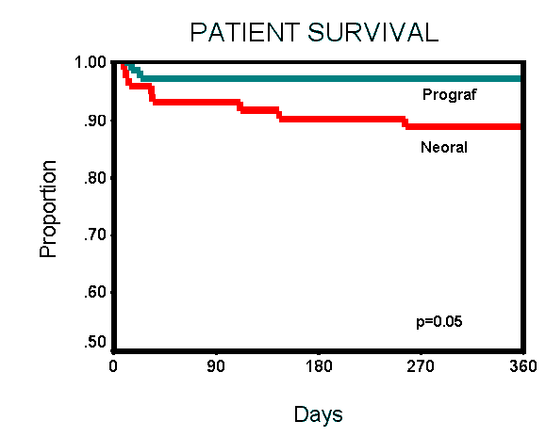
Canadian Prograf vs Neoral Liver Trial
50 Years of Liver Transplantation

Slide 29
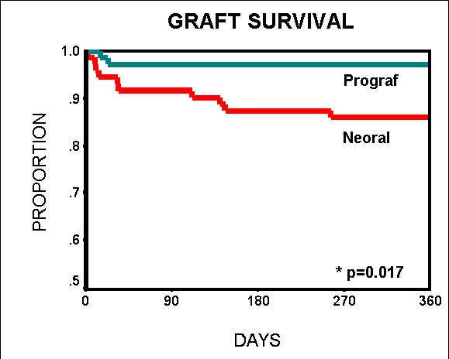
Canadian Prograf vs Neoral Liver Trial
50 Years of Liver Transplantation

Slide 30
Optimize Renal Function
50 Years of Liver Transplantation
MMF
Sirolimus
Everolimus
Antilymphocyte Induction
Thymoglobulin
Zenapax
Simulect

Slide 31
Liver Transplantation at UCLA
50 Years of Liver Transplantation

Slide 32
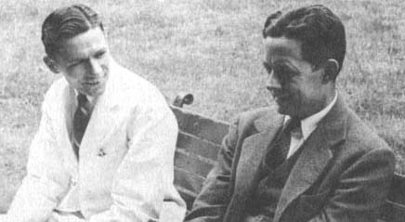
50 Years of Liver Transplantation
William P. Longmire, Jr.
Founding Professor, UCLA School of Medicine
Chairman, UCLA Department of Surgery 1948 - 76

Slide 33
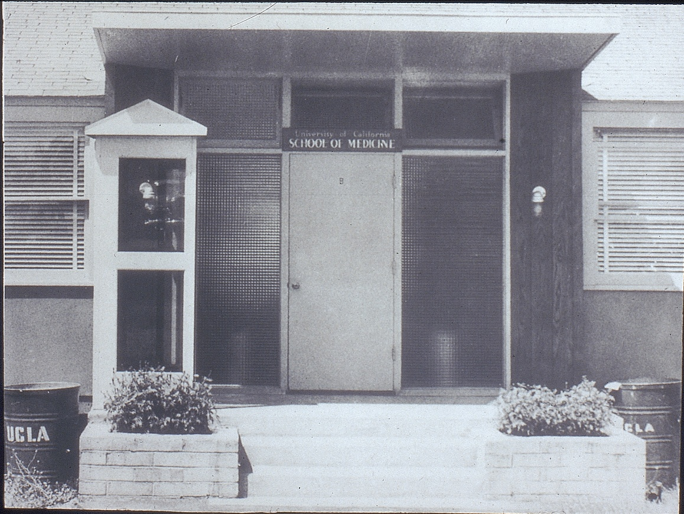
50 Years of Liver Transplantation

Slide 34
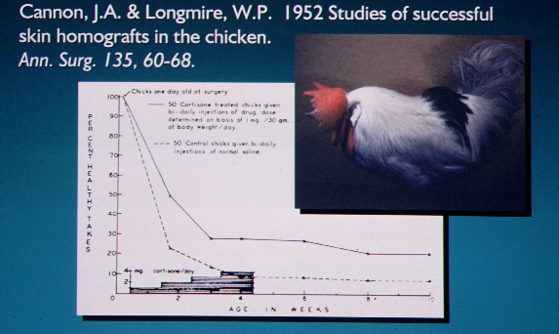
50 Years of Liver Transplantation
Competitors for Induction of Tolerance

Slide 35
50 Years of Liver Transplantation
Cannon and Longmire
Skin grafts of outbred newborn chicks had
high rate of engraftment, 6% permanent take
Grace period for engraftment only 4 days
Cortisone treatment increased permanent
engraftment to >20%
Observations presaged acquired
neonatal tolerance demonstrated by
Billingham, Brent and Medawar

Slide 36
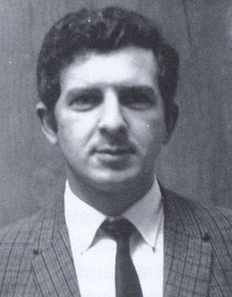
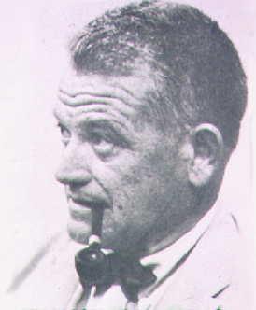
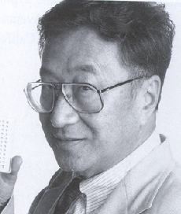
50 Years of Liver Transplantation
Willard E. Goodwin
First to successfully reverse acute rejection with prednisone 1960
Paul I. Terasaki
Description of microcytotoxicity assay for
HLA typing 1964
Description of hyperacute kidney rejection 1965
Role of HLA matching for donor selection 1966, ’70, ’71
Geoffrey Collins
Intracellular electrolyte preservation solution used for two decades

Slide 37
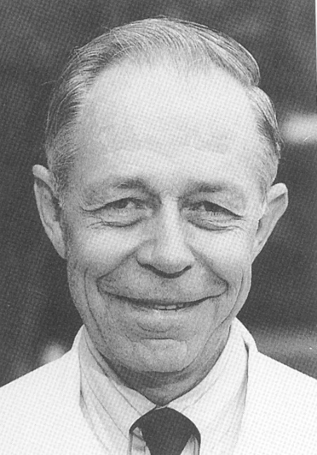
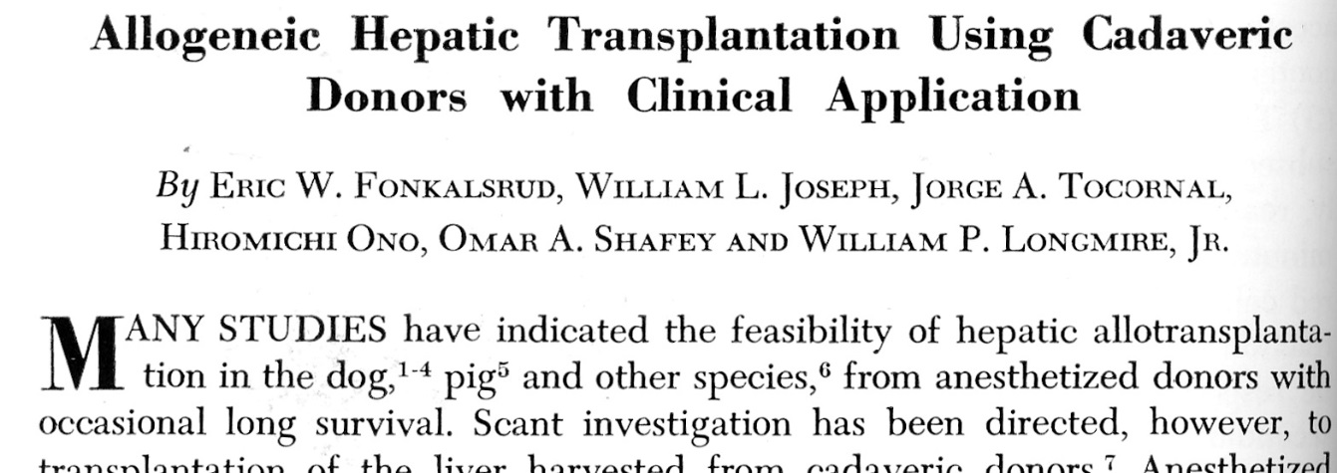
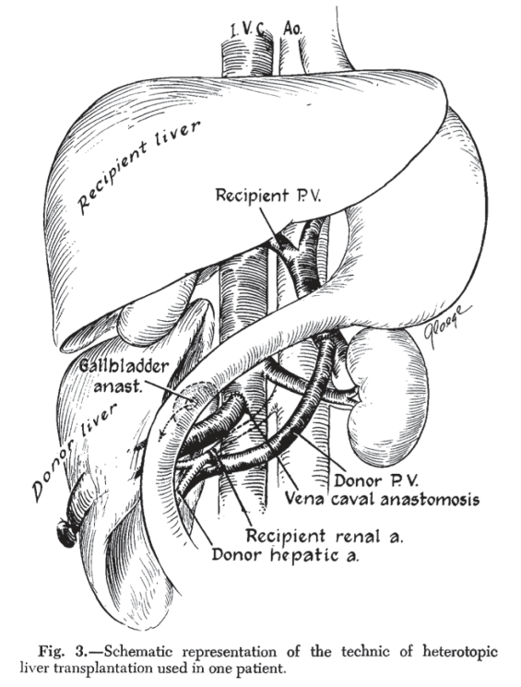
50 Years of Liver Transplantation
First Clinical Attempt at UCLA
Journal of Pediatric Surgery 1968
Eric W. Fonkalsrud, MD
Patient died 12 days after surgery

Slide 38
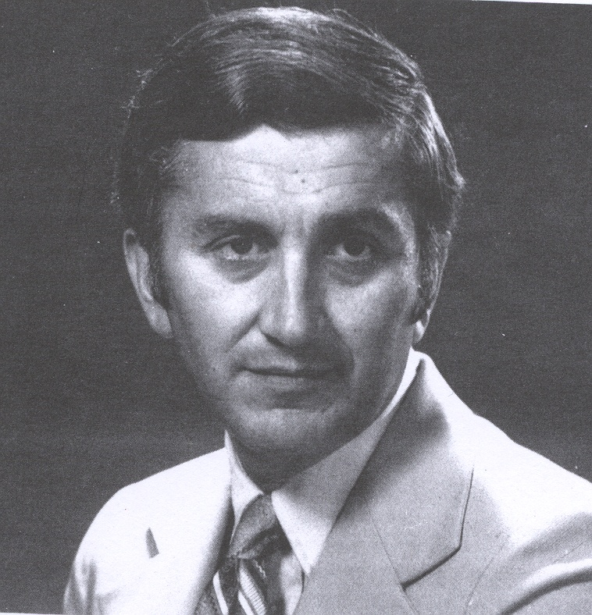
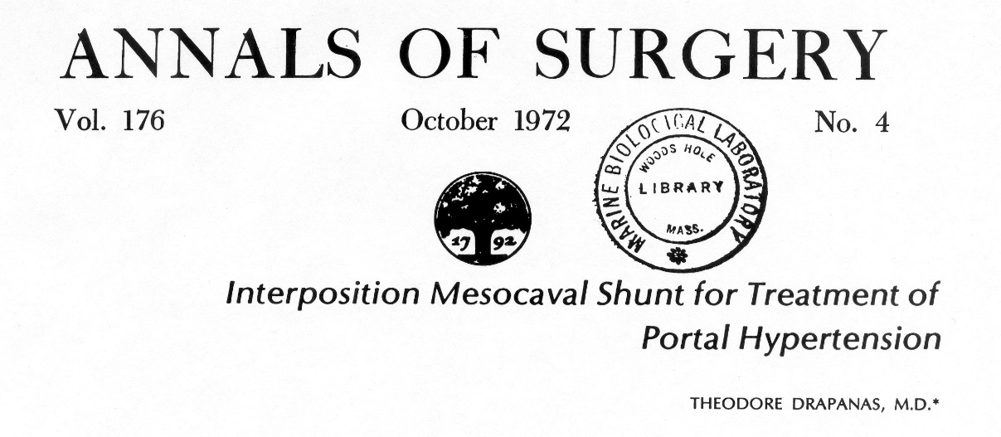
50 Years of Liver Transplantation
Performed first liver transplant at Tulane in 1972
Theodore Drapanas, MD 1930 - 1975
Chairman, Department of Surgery
Tulane University Medical School
1968 - 1975

Slide 39
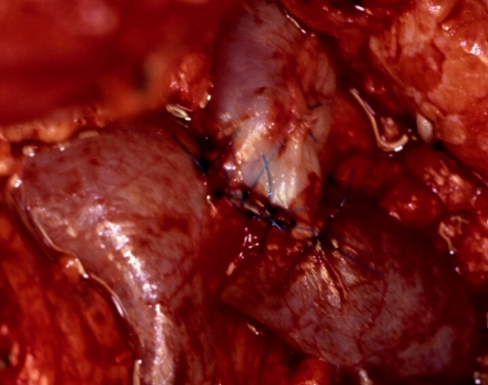
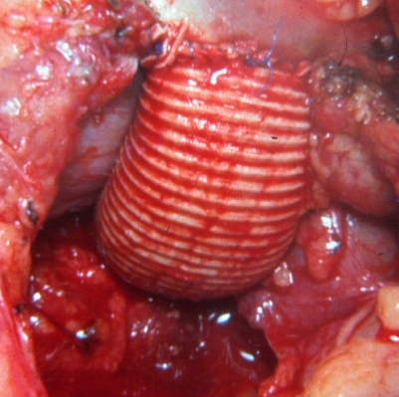
50 Years of Liver Transplantation
Selective vs Nonselective Shunts
In 1978 Dr. Longmire asked me to lead the team to surgically manage patients with portal hypertension

Slide 40
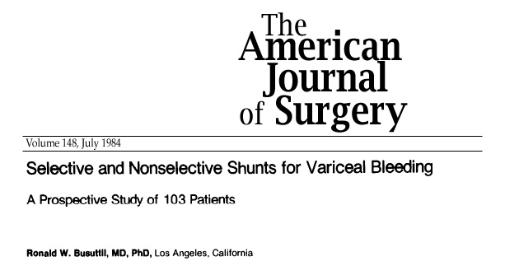
50 Years of Liver Transplantation

Slide 41
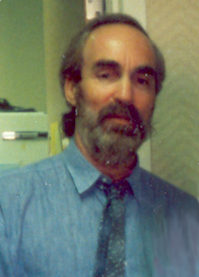
50 Years of Liver Transplantation
19 year old male with congenital hepatic fibrosis and uncontrollable variceal hemorrhage.
DSRS- 4 – 82 – bleeding controlled.
5 days p.o. liver failure
Transfer to Dr. Starzl in Pittsburgh.
Patient died before transfer.
Leonard Goldstein, MD

Slide 42
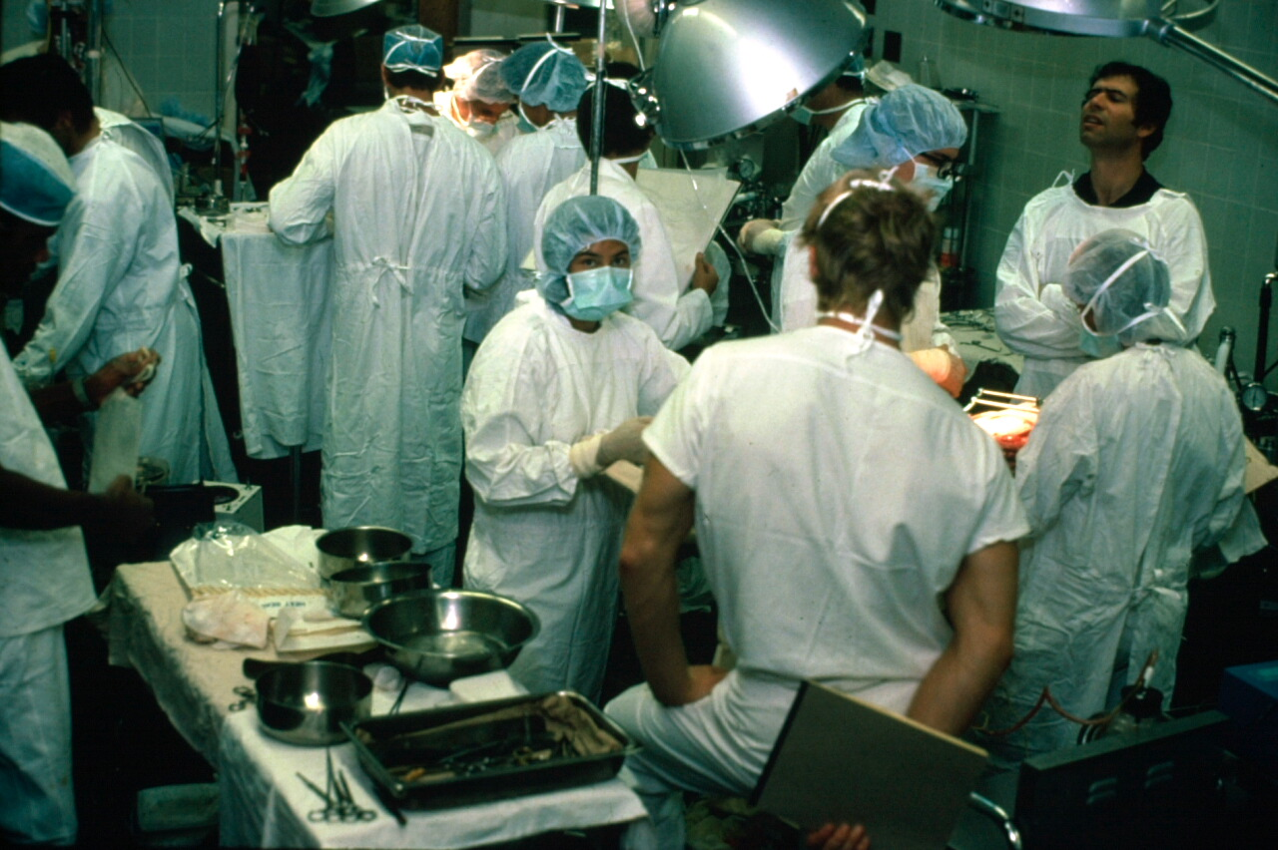
50 Years of Liver Transplantation
Preclinical Trials at UCLA 1982
Memsic, Quinones-Baldrich, Kaufman, Rasool, Busuttil
A Comparison of Porcine Orthotopic Liver Transplantation Using a Venous-Venous Bypass with and without a Nonpulsatile Perfusion Pump. J Surg Res, 1986
Notes:
42

Slide 43
50 Years of Liver Transplantation
Porcine Liver Transplantation*
Operative procedures | 50
Operative survival | 92%
Survival range: 2 wk – 12 mo | Mean 4 mo
* No immunosuppression
Cordier and Garnier, 1966
Calne, 1969
Notes:
43

Slide 44
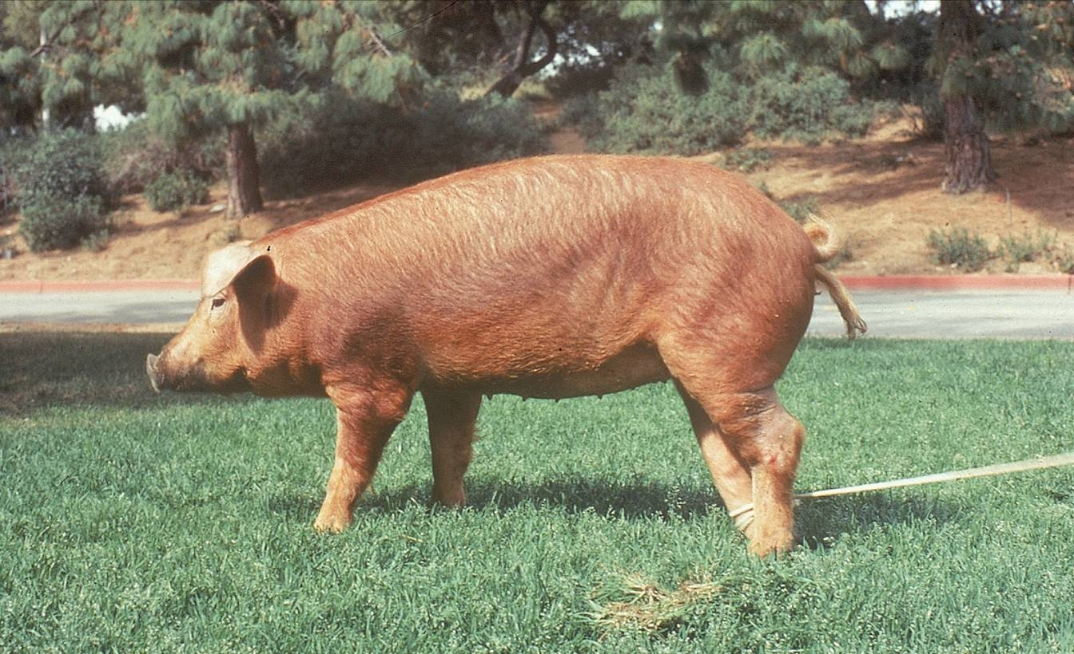
50 Years of Liver Transplantation
Notes:
44

Slide 45
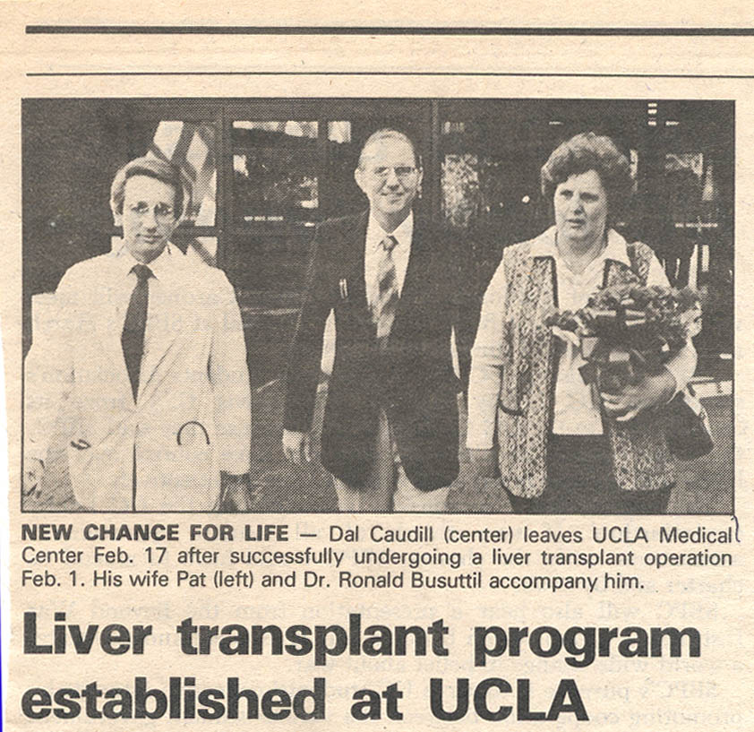
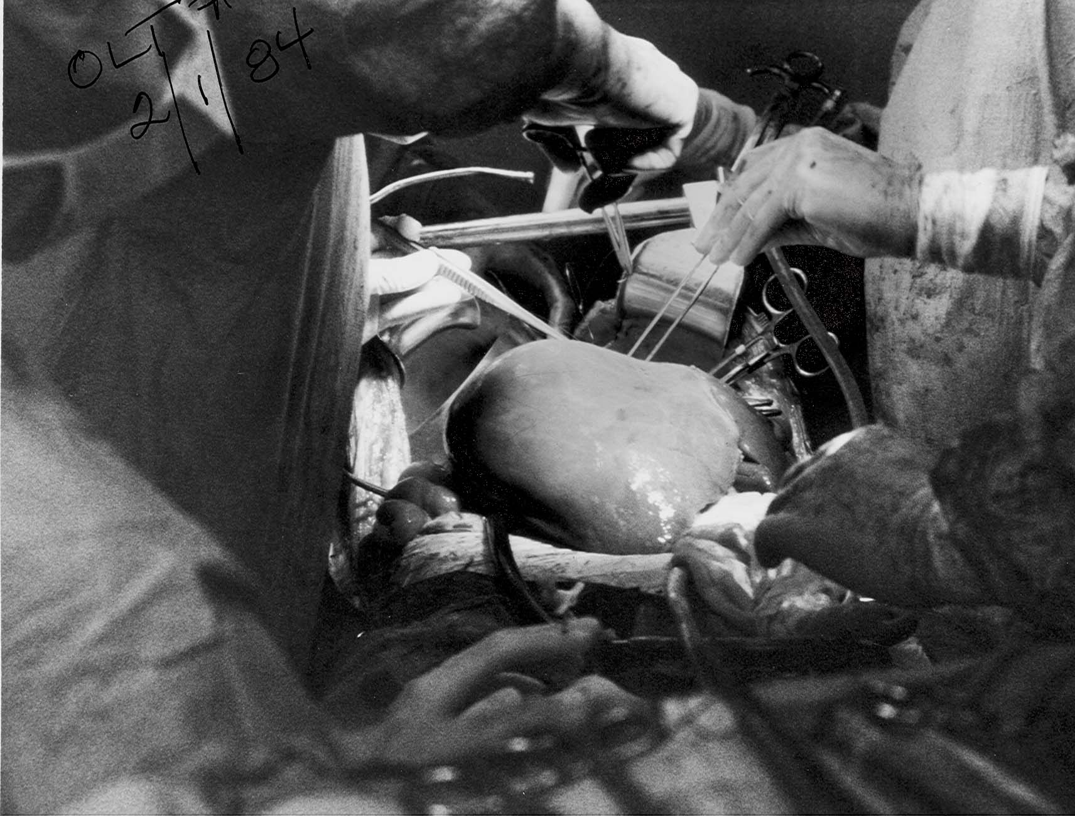
50 Years of Liver Transplantation
First Liver Transplant at UCLA
February 1, 1984

Slide 46

50 Years of Liver Transplantation
US Liver Transplant Centers 1984
n = 5
Notes:
46

Slide 47

50 Years of Liver Transplantation
US Liver Transplant Centers 2017
n = 143
Notes:
47
.

Slide 48
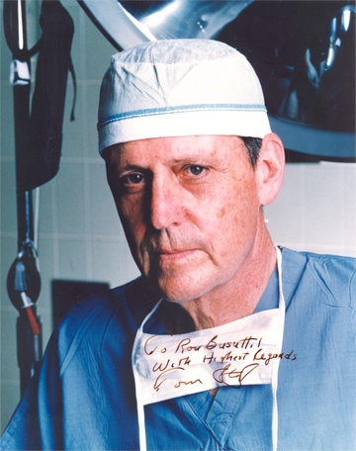
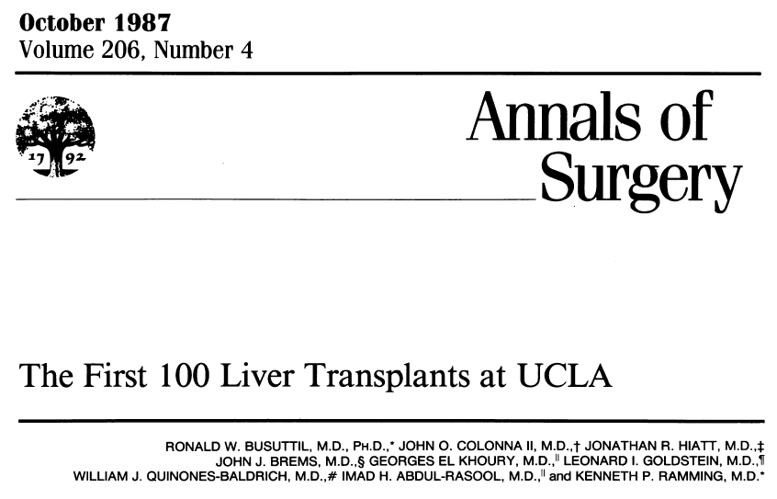
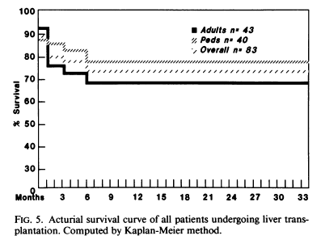
50 Years of Liver Transplantation
First 100 Liver Transplants at UCLA
November 1986
“How well I remember the multiple phone conversations on our first few transplants in which I sought your advice and encouragement and I am very grateful for that.”
RW Busuttil to TE Starzl, ASA Closing Discussion

Slide 49
50 Years of Liver Transplantation
Past
Present
Future
Transforming lives
Notes:
49

Slide 50
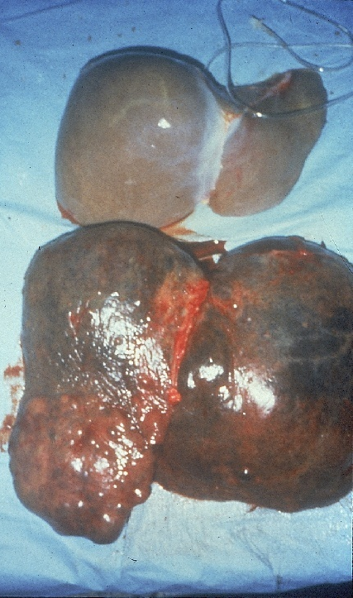
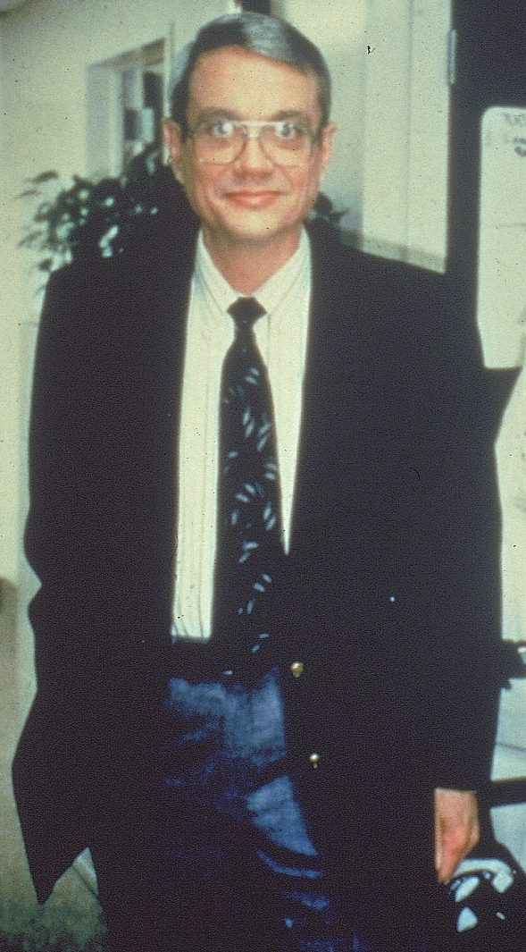
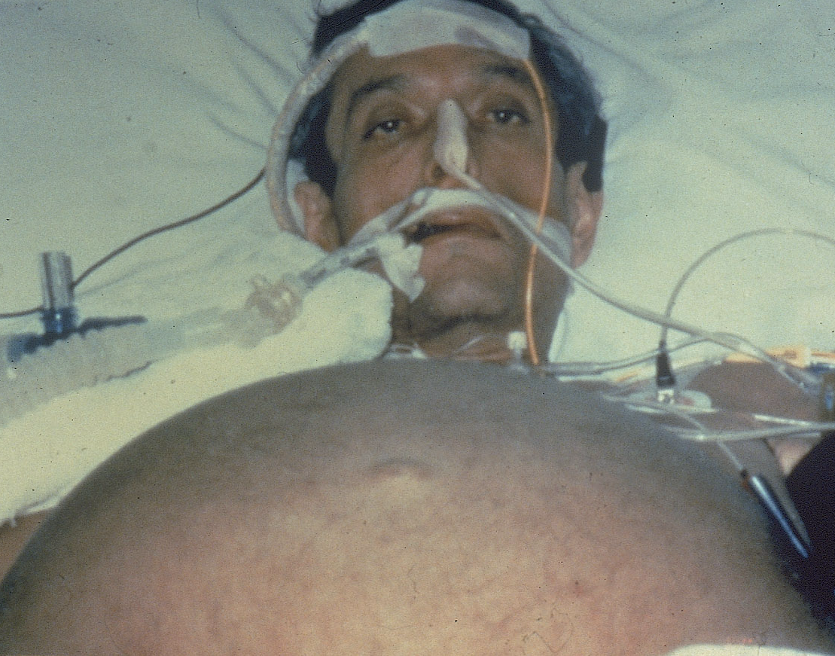
50 Years of Liver Transplantation
Specific Aim
Notes:
50

Slide 51
50 Years of Liver Transplantation
Indications for OLT today
Any and all types
of ESLD both
acute and chronic
Notes:
51

Slide 52

50 Years of Liver Transplantation
Classical Technique
Starzl, SGO 1963
Notes:
52

Slide 53
50 Years of Liver Transplantation
UCLA Techniques for OLT
Classical (75%)
Selective:
  Caval sparing
  Veno-venous bypass
  Arterial and venous conduits
  Simultaneous PV & HA or HA first
  T-Tube use
Notes:
53

Slide 54







50 Years of Liver Transplantation
Liver Transplantation: UCLA Approach
Like Starzl 1963
Supra IVC
Infra IVC
PV
HA
BD
Avg WIT =
25 min

Slide 55
50 Years of Liver Transplantation
UCLA Series, 1984-2012
 | n | %
TOTAL OLT | 5347
Recipient
Primary OLT | 4574 | 86
Retransplant | 773 | 14
Donor grafts
Whole cadaveric | 4820 | 90.1
Split cadaveric | 271 | 5.1
DCD | 122 | 2.3
Living donor | 103 | 1.9
Reduced-size | 31 | 0.6

Slide 56
50 Years of Liver Transplantation
Etiology of End-Stage Liver Disease
Total n=4942
Malignancy (n=955)
No Malignancy (n=3619)

Slide 57
50 Years of Liver Transplantation
Survival by Etiology of ESLD
P<.001
Survival (%)
Biliary atresia
NASH
PSC
Hepatitis B
PBC
HCV
Alcohol
Malignancy
Years

Slide 58
50 Years of Liver Transplantation
Long-Term Survival
Pediatric
Adult
Survival (%)
P<0.001
Years

Slide 59
50 Years of Liver Transplantation
Model for End-Stage Liver Disease
Adopted in 2002
Predicts wait-list mortality
Standard for donor allocation
Prioritizes sickest recipients

Slide 60
50 Years of Liver Transplantation
Observations in the MELD Era
Higher recipient acuity
Diminished donor quality
Improved recipient survival

Slide 61
50 Years of Liver Transplantation
Era Comparison – Recipient Acuity
 | Pre-MELD (’84-’02) | Post-MELD (’02-present) | P
Recipients, n | 2678 | 2099
OLT, n | 3218 | 2341
MELD | 19 | 28 | <.001
MELD ≥ 35 | 13% | 37% | <.001
 | National | UCLA
MELD in 2011 | 22 | 38

Slide 62
50 Years of Liver Transplantation
Patient Survival by Era
Post-MELD
Survival (%)
Pre-MELD
 | yrs: | 1 | 5 | 10
Pre-MELD |  | 77 | 66 | 58
Post-MELD |  | 82 | 70 | 65
P<.001
Years

Slide 63
50 Years of Liver Transplantation
Survival by Era with High MELD
Post-MELD ≥ 34
Survival (%)
Pre-MELD ≥ 34
P<.001
 | yrs: | 1 | 5 | 10
Pre-MELD |  | 65 | 55 | 45
Post-MELD |  | 77 | 67 | 60
Years

Slide 64
50 Years of Liver Transplantation
Past
Present
Future
Transforming lives
Notes:
64

Slide 65
50 Years of Liver Transplantation
Challenges Ahead
Expand the number of useable donor organs (Work in Progress)
Improve therapies to treat recurrent hepatitis C after transplant. (Done)
Dual Organ Transplant
Improved detection, risk stratification and biomarkers for HCC (Work in Progress)
Improvement of results for hepatic based malignancies

Slide 66

50 Years of Liver Transplantation
Combined Transplants

Slide 67
50 Years of Liver Transplantation
Combined Transplant (Heart-Liver)
CHLT is a relatively rare event
97 reported cases in US between 1987-2010
  Mean age 44 years
  Male 70%
  Mean MELD 14
  Amyloidosis most common indication - 28%
Liver and Cardiac graft survival
  1-year 83%
  10-year 71%
Graft survivals in CHLT are similar to graft survival in liver alone and heart alone transplantation
Cannon, Transpl Int 2012

Slide 68
50 Years of Liver Transplantation
Multivisceral

Slide 69


Intestinal Transplantation at UCLA
November 12th, 1991
50 Years of Liver Transplantation
The first attempted and successful intestinal transplant at UCLA
Western Journal of Medicine (1993)

Slide 70
UCLA Total Experience
50 Years of Liver Transplantation
Douglas G. Farmer, MD
Director, Intestinal Transplantation
November 1991 – December 2015
141 Intestinal transplants
119 Recipients
  72% Children (≦18 years)
  Mean age: 15 +/- 17 yrs
  45% hospitalized at time of transplantation

Slide 71




50 Years of Liver Transplantation
ISOLATED
INTESTINE
23%
LIVER
INTESTINE
57%
MULTI-
VISCERAL
14%
MODIFIED
MULTIVISCERAL
6%

Slide 72

Overall Graft & Patient Survival
50 Years of Liver Transplantation

Slide 73
Liver Transplantation for Hepatic Malignancy
50 Years of Liver Transplantation
Hepatocellular Carcinoma
Cholangiocarcinoma

Slide 74

Liver Transplantation for HCC
50 Years of Liver Transplantation
Gold standard for unresectable HCC
  Tumor location, number and size
  Underlying cirrhosis
Eligible recipients receive priority based on wait time
Pretransplant locoregional therapy (LRT) mitigates risk of tumor progression
Hepatitis B
Hepatitis C

Slide 75
Liver Transplantation: Past, Present and Future
Liver Transplantation for HCC
Institution | Yr |  | Tumor > Milan | 5 yr survival, %
 |  |  |  | Inside | Outside
Milan |  | ’96 | No | 85 | 50
UCSF |  | ’01 | Yes (6.5cm) | 64 | 36
UCLA |  | ’06 | Yes (UCSF) | 69 | 32
Tokyo |  | ’03 | Stage 2 only | 70 | 30
BCLC |  | ’03 | No | 60 | 46
Hangzhou |  | ’06 | Yes (8cm) | 77 | 21
Kyoto |  | ’08 | Yes (6.5cm) | 79 | 53
New Milan |  | ’08 | Yes (up to 7) | 71 | 64
Notes:
75
Slide 22
Results from ours and other centers show consistent achievement of 5-year post-transplant survival near or above 50% for tumors beyond Milan criteria based on explant pathology.

Slide 76










Locoregional Therapy in HCC
50 Years of Liver Transplantation
Transarterial
Ablative
RFA
TACE
MWA
Y-90
PEI

Slide 77
Effect of Response to Locoregion Therapy on Liver Transplantation for HCC
50 Years of Liver Transplantation
92
81
79
Complete PR
73
63
No/Partial PR
P =.006
56
Agopian, Ann Surg, 2015

Slide 78
Effect of Response to Locoregion Therapy on Liver Transplantation for HCC
50 Years of Liver Transplantation
No/Partial PR
18%
Complete PR
2%

Slide 79
Complete Pathologic Response in Liver Transplantation for HCC
50 Years of Liver Transplantation
cPR with LRT predicts tumor free survival with negligible recurrence
Response to LRT, recipient MELD, and tumor diameter predict cPR
Combination of TACE and ablation increases likelihood of achieving cPR

Slide 80

Cholangiocarcinoma
50 Years of Liver Transplantation
Diagnostic Challenges
  Nonspecific symptoms
  Known risk factors in only 10% patients
  No effective screening test
Prognosis grim if unresectable
  Expected survival 6-12 months
Treatment difficult
  Aggressive
  Location near critical structures
  No effective adjuvant therapy
Intrahepatic
(5-10%)
Hilar
(60-70%)
Distal
(20-30%)

Slide 81
Liver Transplantation for Cholangiocarcinoma
50 Years of Liver Transplantation
Liver Transplantation
  Achieves tumor-free margins
  Treats parenchymal and vascular invasion
  Treats underlying tumor

Slide 82
Liver Transplantation for Cholangiocarcinoma at UCLA
50 Years of Liver Transplantation
Multivariate Predictors of CCA Recurrence after Liver Transplant
 | HR | P | Points
Multifocality | 9.6 | <.01 | 4
Perineural invasion | 8.3 | <.01 | 4
Infiltrative subtype | 5.3 | .03 | 3
No neoadj / adj rx | 4 | <.01 | 3
History of PSC | 2.5 | .06 | 2
Lymphovascular inv. | 2.1 | .09 | 1
Hilar vs. intrahepatic | 1.8 | .17 | 1

Slide 83
Liver Transplantation for Cholangiocarcinoma at UCLA
50 Years of Liver Transplantation
N=132

Slide 84
Summary
50 Years of Liver Transplantation
Locally advanced intrahepatic & hilar CCA
  Chemotherapy with OLT superior to radical resection
Current criteria for OLT (Mayo Criteria)
  Restrictive to small and early stage hilar CCA only
  Potentially curable patients excluded
UCLA experience advocates OLT for CCA
  Locally advanced intrahepatic and hilar tumors

Slide 85
Novel Indications for
Liver Transplantation
50 Years of Liver Transplantation
Metastatic Colorectal Cancer
Neuroendocrine Tumors
Acute Alcoholic Hepatitis

Slide 86
50 Years of Liver Transplantation
Past
Present
Future
Transforming lives
Notes:
86

Slide 87
50 Years of Liver Transplantation
“… perhaps I could shed light on how advances occur in clinical medicine; … how the patients themselves inevitably emerge as the heroes”
T.E. Starzl, The Puzzle People
(Preface)

Slide 88

50 Years of Liver Transplantation

Slide 89






50 Years of Liver Transplantation
11 months
1 year
4 years
26 years
28 years
30 years
One life saved among thousands

Slide 90




50 Years of Liver Transplantation
In Situ Splitting of Liver
Hasan Yersiz, MD
Early L/R recipient pair
Over 260 split liver recipients
Notes:
90

Slide 91



50 Years of Liver Transplantation
Dad
2008
Daughter
2016
Donor
Recipient
1993
First Living Donor Case

Slide 92


50 Years of Liver Transplantation
LD and Split Liver Transplantation
Overall 10-Yr Survival
Patient
Graft
Hong, JACS 2009
Notes:
92

Slide 93



50 Years of Liver Transplantation
Domino Transplantation
Donor
Donor/Recipient
Recipient

Slide 94


50 Years of Liver Transplantation
Met on the Transplant Ward in 2007
2008
Wife
Husband
2014
2011

Slide 95


50 Years of Liver Transplantation
The 6000th Liver Transplant
Performed at UCLA
June 30, 2016

Slide 96

50 Years of Liver Transplantation
2017 Dumont-UCLA Transplant Center Team Photo
Notes:
Here is the UCLA Liver Transplant in front of our Ronald Reagan Hospital which opened on June 29, 2008. On that day a liver transplant was the second operation performed after an appendectomy.
This UCLA team is modeled after and functions as Dr Starzl taught us.

