Slide 1
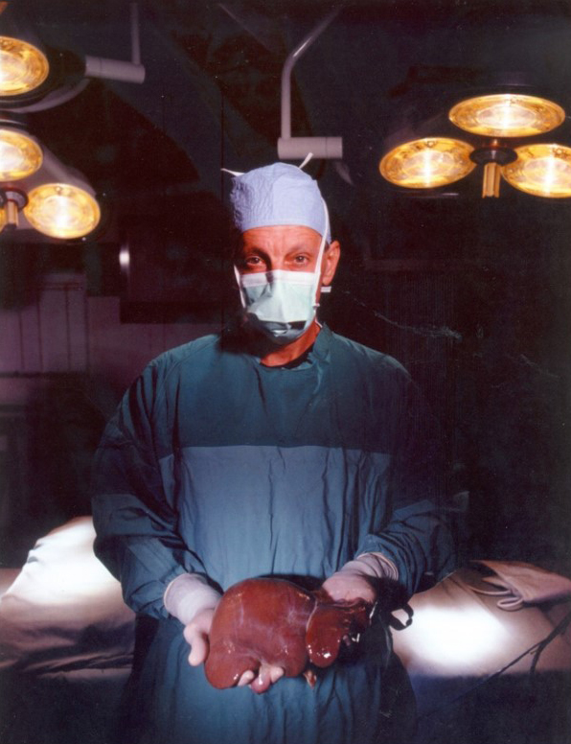
Prof. Ronald W. Busuttil, MD
Laudatio

Slide 2
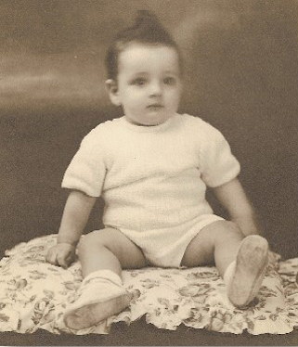
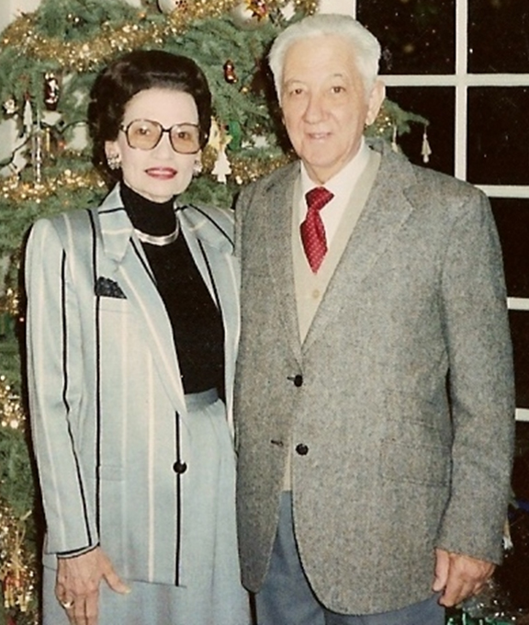
Born in Alessandria (Egypty) May 25th 1945

Slide 3
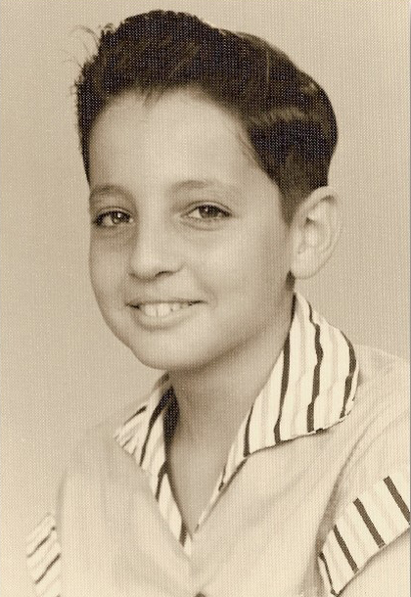
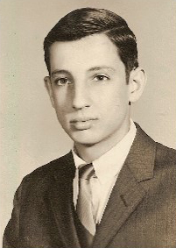
Moved to USA and Grew up in Tampa Florida
Bachelor of Science in Biology (Magna Cum Laude) at Loyola University, New Orleans, Louisiana working on inflammation produced by lysosomes
In the eighth grade he wrote an essay titled,
“I Want to be a Surgeon.”

Slide 4
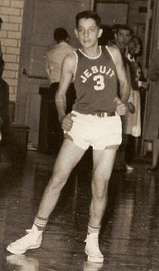
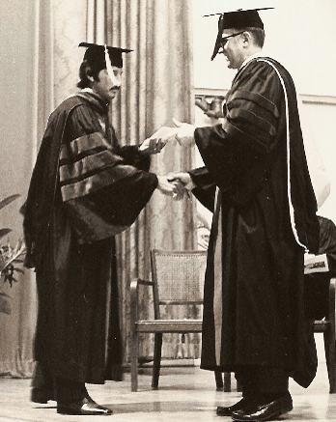
Playing basketball at
Tampa Florida Jesuit High School
1971 MD at Tulane University School of Medicine,
New Orleans
Busuttil worked with Dr. Elmo Cerise, a surgeon who ran a program that brought medical students into the operating room.
“It told me that surgery was what I wanted to do for the rest of my life,” Busuttil says.

Slide 5
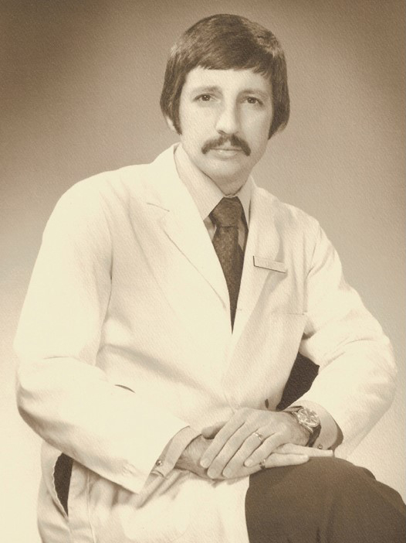
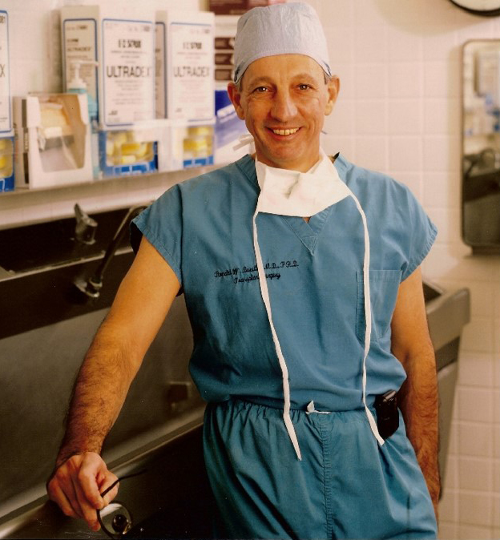
1978 Certification of American Board of Surgery University of California Los Angeles (UCLA)
“He is an inspired leader” Calcaterra says, “He’s universally looked up to as a surgeon and he really wants to make the department No. 1 in the country“
Trained in transplantation at UPMC with prof. Thomas Starzl
“I would score Ron Busuttil with a 10 on a scale of 10 in all areas” Starzl says

Slide 6
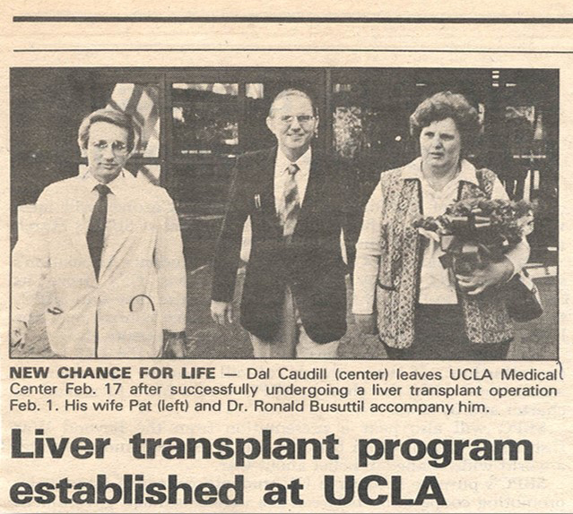
1984 founder of the liver transplant program at UCLA
Director of The Dumont-UCLA Transplant Center Ronald Reagan UCLA Medical Center, Los Angeles

Slide 7
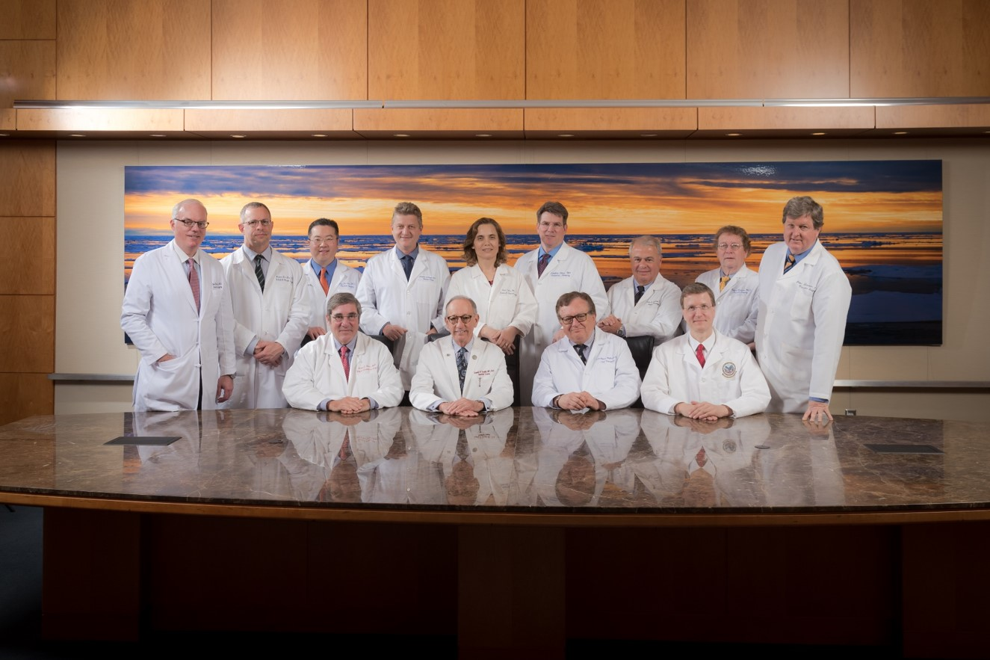
1994-2004 Director of the Department of Surgery UCLA

Slide 8
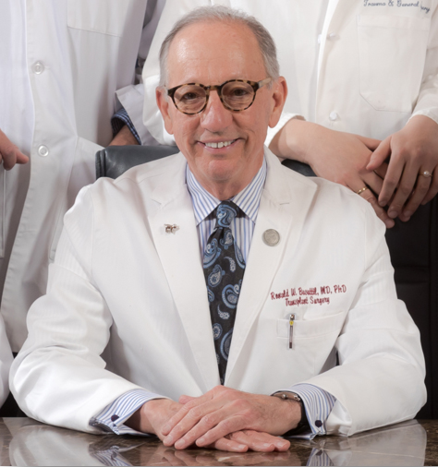
Distinguished Professor of Surgery The William P. Longmire, Jr. Chair in Surgery, Department of Surgery David Geffen School of Medicine – UCLA
“He built the program against the odds. He’s like a guy who built a go-cart in his garage and flew it to the moon”
Dr. Jonathan Hiatt
Vice Dean UCLA

Slide 9
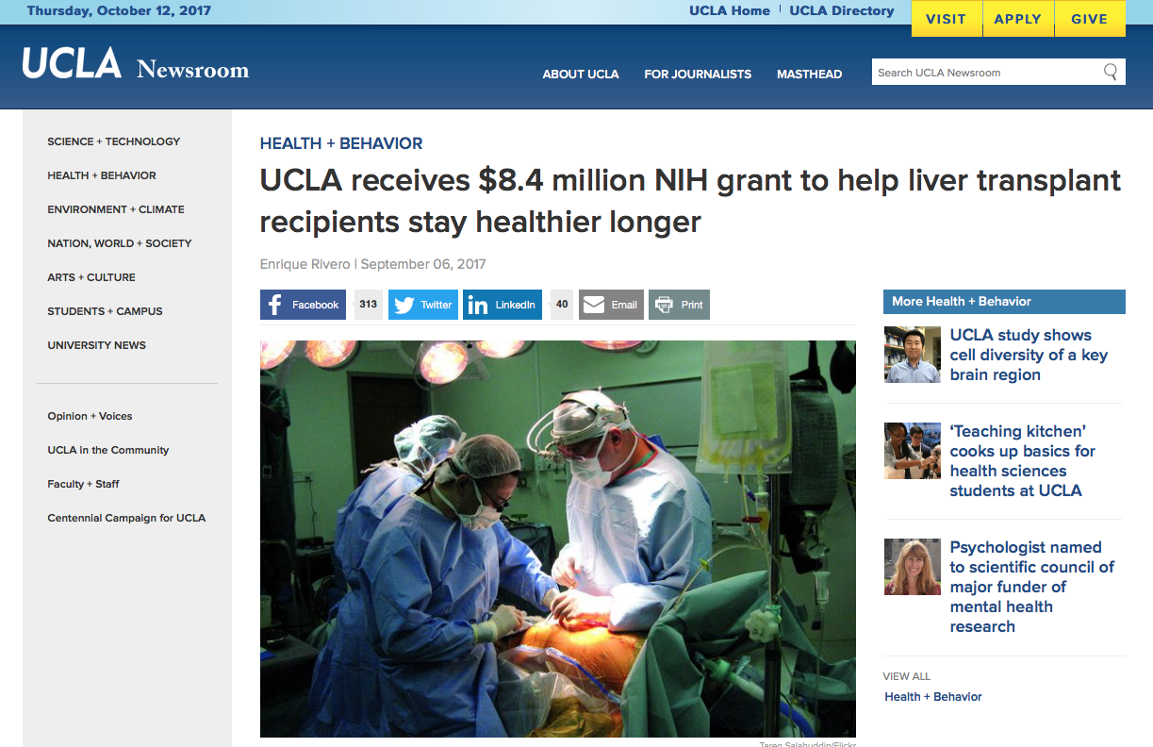
Principal Investigator or Co-Investigator in numerous scientific international projects, collecting more than 30 million of USD as fund-raising

Slide 10
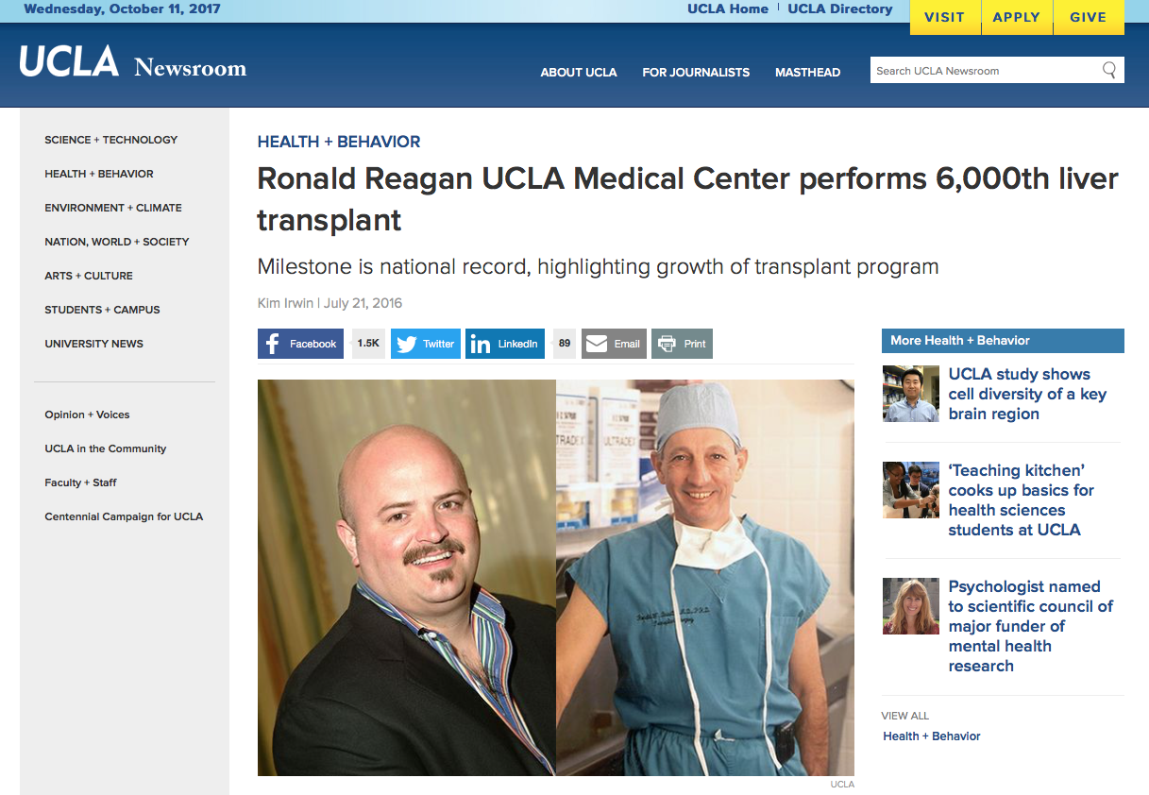

Slide 11
Prof. Busuttil was the mentor and personally trained more than 30 US surgical fellows and contributed to prepare at least 300 surgeons
now working in apical position in Europe and Asia

Slide 12
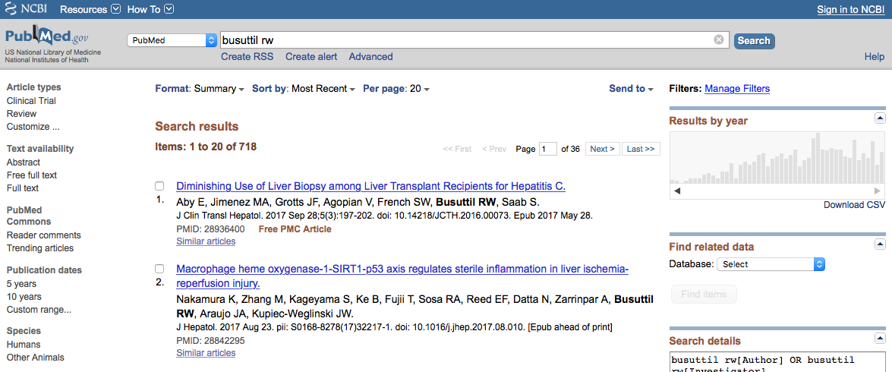
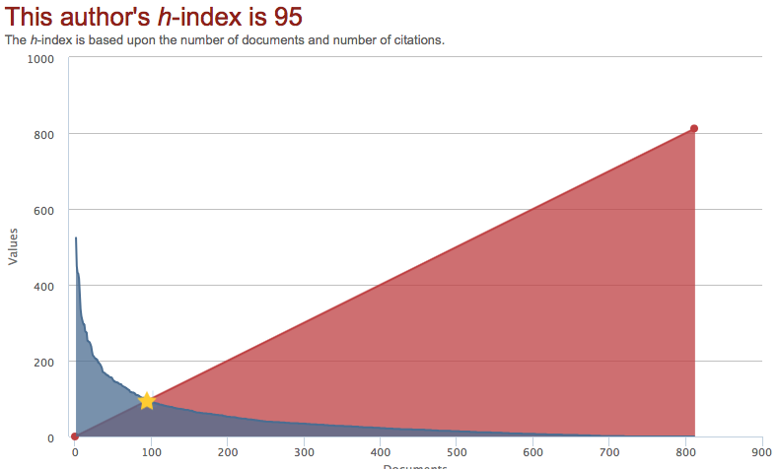
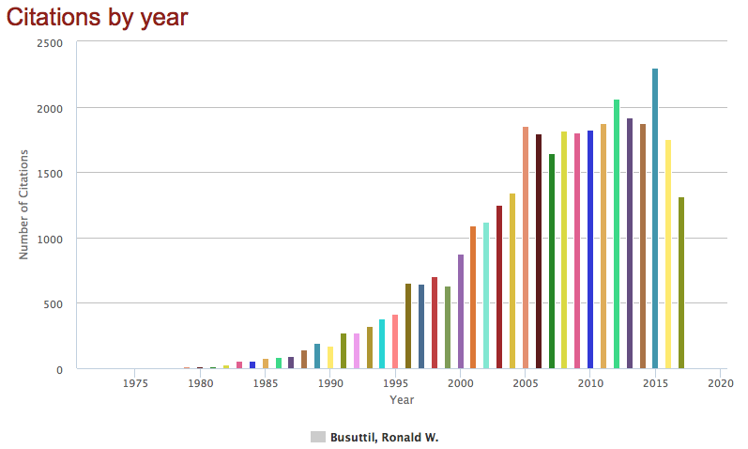
Scientific activity

Slide 13
The Holy Bible of liver transplant surgeons

Slide 14
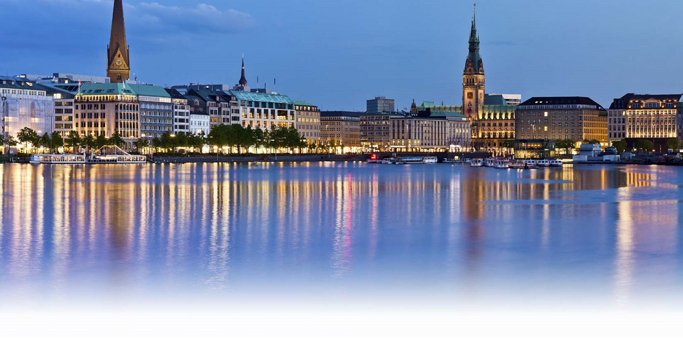
In late 90’s I first met Ronald in Hamburg….

Slide 15
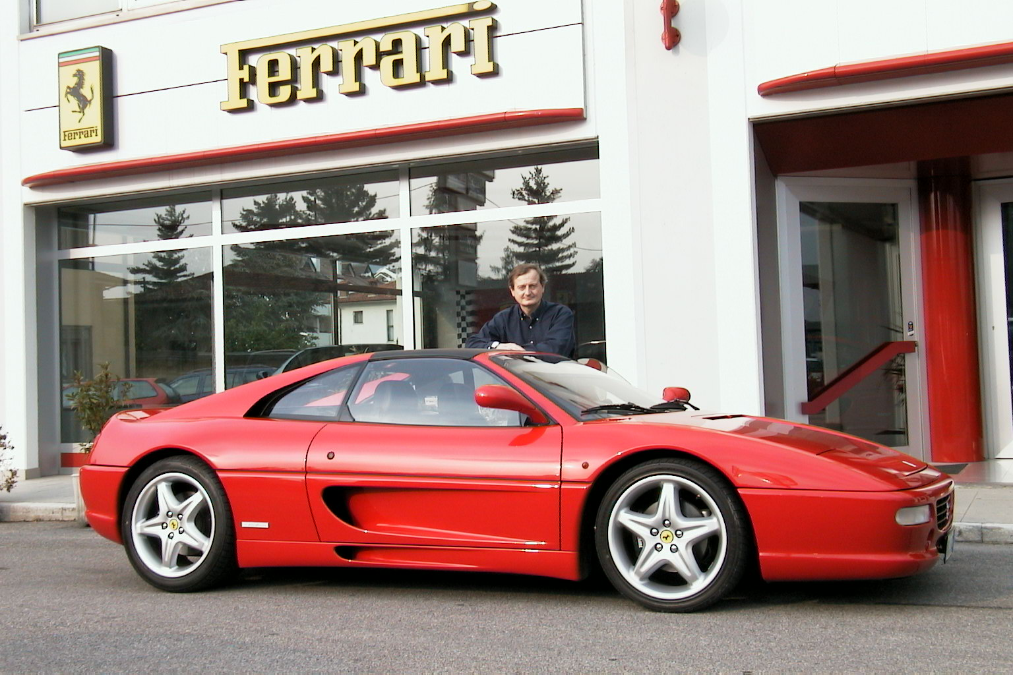
Trying to sell him my Ferrari 350 GT
Prince De Curtis “Totò” tries to sell the Trevi fountain to an american tourist

Slide 16
…and a Ferrari 250 GT LWB Berlinetta Scaglietti

Slide 17
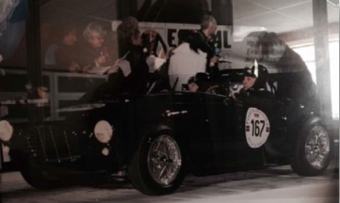
Ron is a sportive car enthusiast and participated at several Mille Miglia races driving his 1952 Siata 400L

Slide 18
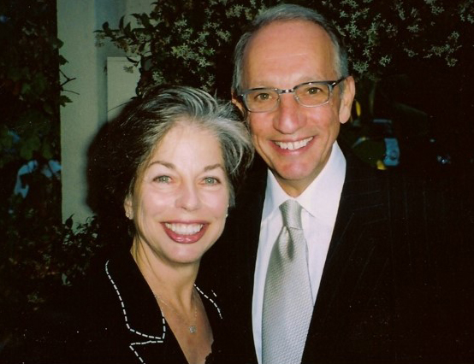
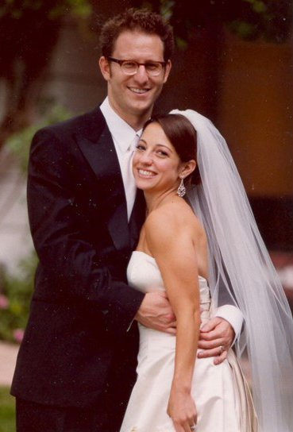
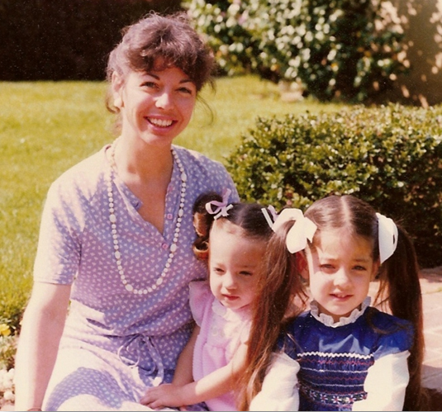
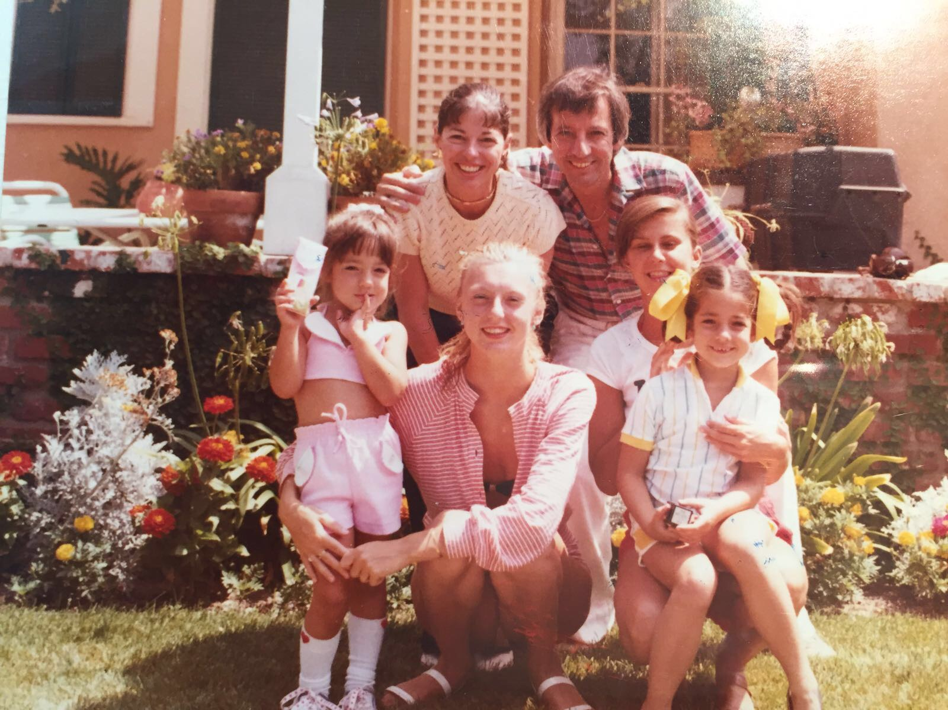
Proud of his life and his US family…
and his Italian family

Slide 19
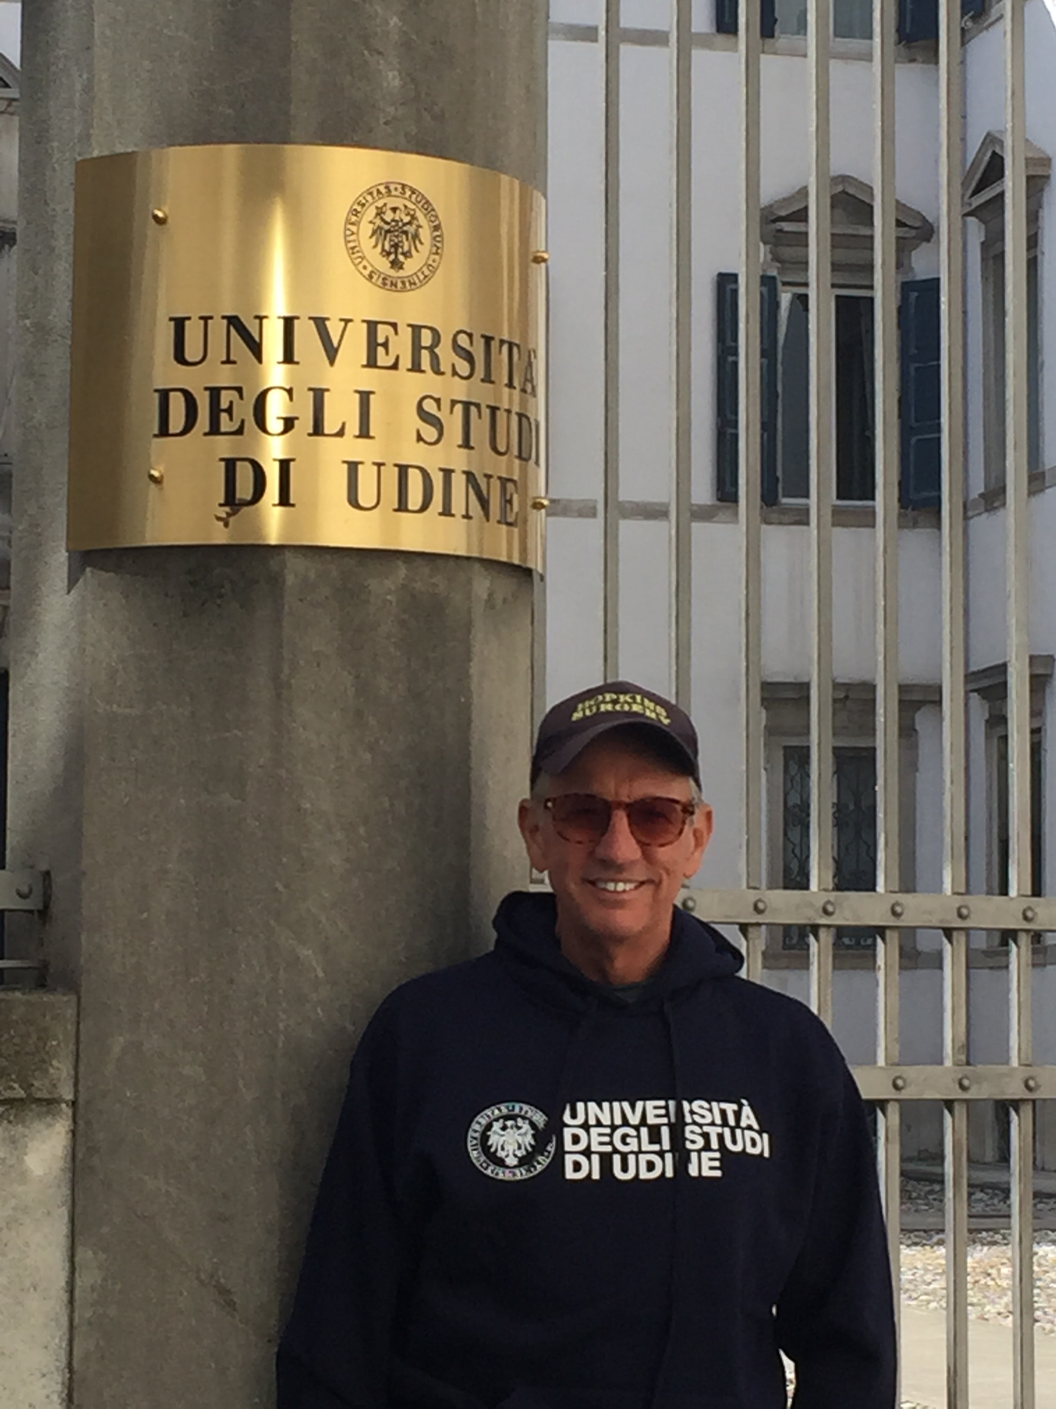
A very good friend of Udine and Friuli Venezia Giulia

